Slide 1

Autonomous navigation system for rover
24aim113 – introduction to nn , cnn and gnn
24aim114 – analog system design
Team members :
Akhillesh varathan cs – cb.ai.u4aim24102
Jeffrin merino j – cb.ai.u4aim24118
K Deepak Skandh – cb.ai.u4aim24119
Kavin m – cb.ai.u4aim24121

Slide 2
Introduction :
Autonomy refers to the ability of a system, machine, or robot to operate independently without human intervention. It involves Decision-making, Self-navigation and Path Planning.
Autonomy enables machines to perform tasks such as obstacle avoidance, path planning, and real-time adjustments, making them useful in various applications like space exploration, self-driving cars and industrial automation. adaptive responses to environmental changes.

Slide 3
Abstract:
Our project develops an autonomous rover navigation system, integrating a sensor-equipped steering mechanism to enable precise and efficient navigation
Our system utilizes a YOLO-based object detection model to identify obstacles and navigate through challenging environments.
Experimental results demonstrate the effectiveness of our approach, achieving an accuracy of 94.66% and a recall of 78.51% in object detection.

Slide 4
methodology
Collected the Data which includes common indoor obstacles to train the model.
Converted labels from JSON format to TXT format which is feasible for yolo.
Applied Data-Augmentation techniques to increase the data size and improve diversity.
Trained the Model using Pre-processed data.
Used the Trained model to predict the coordinates of the obstacles.
Assessed the Performance of the model using relevant metrices.

Slide 5
YOLO ( YOU ONLY LOOK ONCE ):
YOLO is an Real time objection detection Algorithm that uses Neural Network to predict both Bounding boxes and Class Prediction.
Convolutional Layers:
5 convolutional blocks with increasing filters (16 → 256).
Each block includes Batch Normalization and LeakyReLU activation
Fully Connected layers:
Output layer with( Number of class + 5) where 4 is for bounding box, 1 for confidence score.
Loss Function:
Combines bounding box loss(MSE),Confidence loss(BCE) and Classification loss(Cross-Entropy)
Training:
Adam optimizer with learning rate 0.001

Slide 6
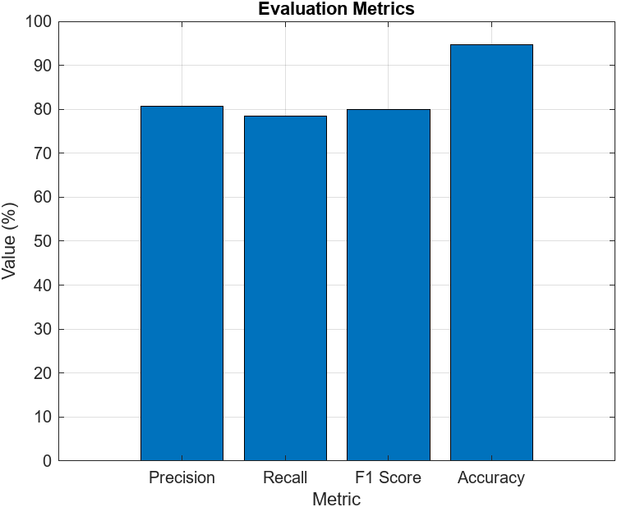
Result:
Trained YOLO model achieves strong object detection performance, with 94.66% accuracy, 80.77% precision, 78.51% recall, and an F1 score of 79.90%.

Slide 7
Discussion:
The recall of 78.51% suggests that the model is able to detect most objects, but may miss some instances.
The F1 score of 79.90% provides a balanced measure of both precision and recall, indicating that the model is able to achieve a good balance between accuracy and completeness.
Future Works
Further tuning of hyperparameters to optimize performance-
Exploration of other object detection architectures and techniques
Investigation of methods to improve recall and reduce false positives

Slide 8
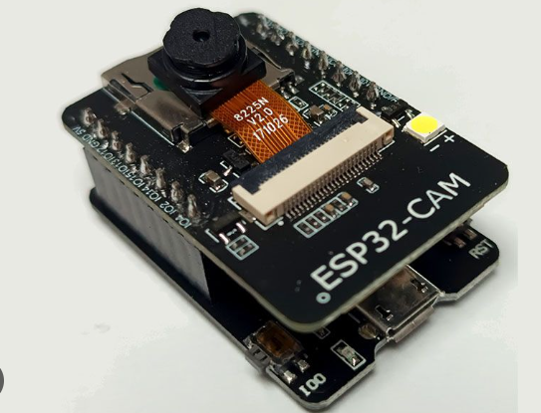
Sensors:
ESP32-CAM module:
Small-size, low-power camera module- OV2640 camera sensor.
Onboard TF card slot- 4MB PSRAM for image buffering.
Enables higher-quality pictures and video streaming without crashing the ESP32.
Reception Sensitivity:
CCK-1MBPS-90 dBm
Transmitting power:
802.11b: 17 ±2dBm(@11Mbps)
802.11g: 14 ±2dBm(@54Mbps)
802.11n: 13 ±2dBm(@HT20,MCS7)

Slide 9
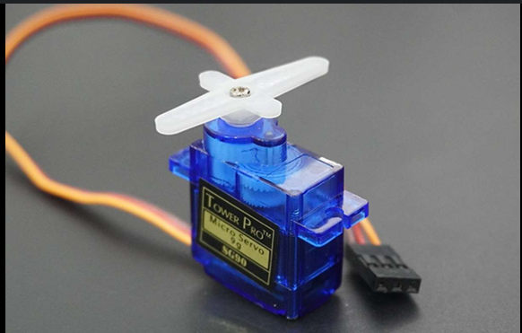
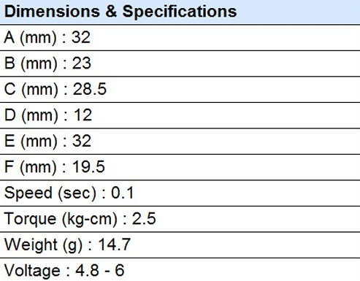
SERVO MOTORS:
Servo motor enables controlled , smooth , and precise movements.

Slide 10
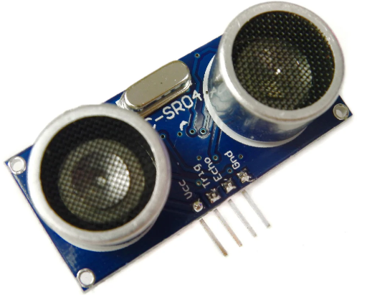
Ultrasonic Sensor(HC-SR04)
Operating voltage: +5V
Theoretical Measuring Distance: 2cm to 450cm
Practical Measuring Distance: 2cm to 80cm
Accuracy: 3mm
Measuring angle covered: <15°
Operating Current: <15mA
Operating Frequency: 40Hz

Slide 11
WORK DONE:
BEFORE REVIEW-1
1.Model architecture.
2.Literature review.
AFTER REVIEW-1
1.Build an Neural Network Model for Object Detection
2.Integrated with ultrasonic sensor and servo motor.

Slide 12
THANK YOU

